Slide 1

BigQuery Features
February 9,2024

Slide 2

Contents
1 | Introduction to Bigquery
2 | Bigquery Partitioned Tables
3 | Bigquery Clustered Tables
4 | Bigquery GIS
5 | Bigquery ML

Slide 3
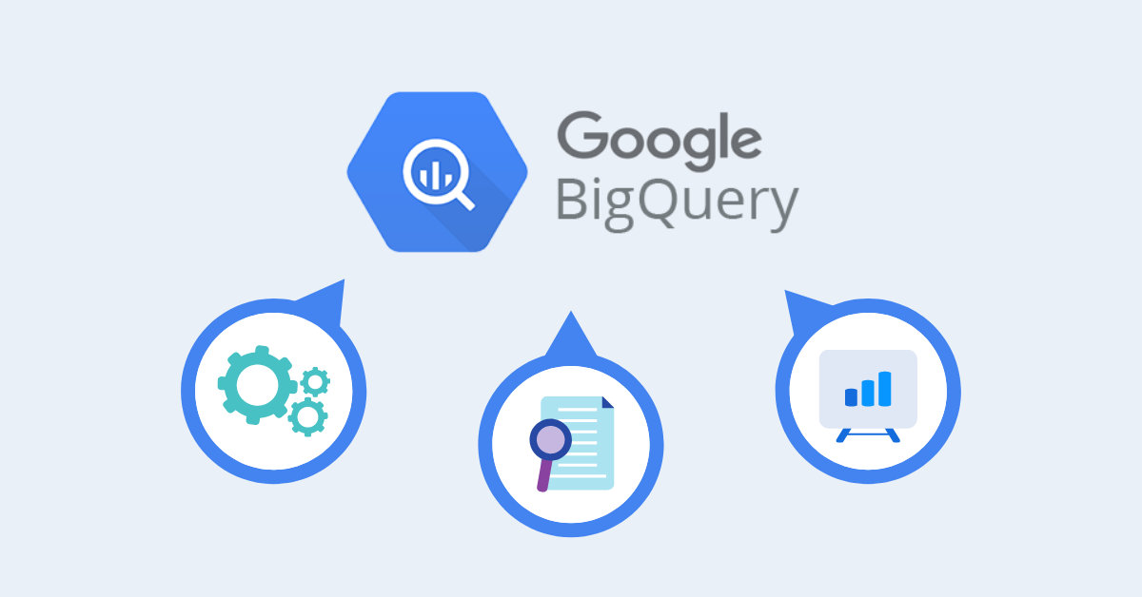
1. Introduction to BigQuery
Google BigQuery is a fully managed, serverless, and highly scalable data warehouse solution provided by Google Cloud Platform (GCP).
It enables organizations to analyze massive datasets quickly and cost-effectively using SQL queries.
It helps to manage and analyze data with built-in features like machine learning, geospatial analysis, and business intelligence etc.

Slide 4
2. BigQuery Partitioned Tables
BigQuery supports partitioning tables, which can significantly improve query performance and reduce costs
A partitioned table is divided into segments, called partitions, that make it easier to manage and query your data.
We partition tables by specifying a partition column which is used to segment the table.
If a query uses a qualifying filter on the value of the partitioning column, BigQuery can scan the partitions that match the filter and skip the remaining partitions. This process is called pruning.
When to use partitioning
Want to improve the query performance by scanning portion of table
To reduce the cost of bytes read by query

Slide 5
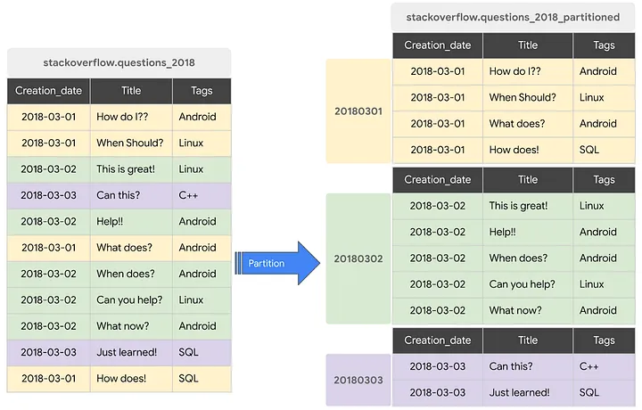

Slide 6
Types of Partitioning
BigQuery supports three types of partitioning:
Integer range partitioning: We can partition a table based on an integer column. We can specify the range and interval of the partitions.
Example:(1,100,10)-->(start,end,interval)
Time-unit column partitioning: We can partition a table based on a date, timestamp, or datetime column, such as a transaction date or a creation timestamp. We can choose the granularity of the partitions, such as daily, monthly, or yearly.
Example: 2019-01-01, 2021-05-07 17:22:00
Ingestion time partitioning: We can partition a table based on the time when BigQuery ingests the data, such as the load job time or the streaming insert time. We can choose the granularity of the partitions, such as hourly or daily.
Example: 2021-05-07 17:40:00
Special Partitions: __NULL__ (Contains rows with NULL values in the partitioning column), __UNPARTITIONED__(Contains rows where the value of the partitioning column is outside the range).

Slide 7
Limitations of BigQuery Partitions
We cannot use legacy SQL to query partitioned tables or to write query results to partitioned tables.
BigQuery does not support partitioning by multiple columns. Only one column can be used to partition a table.
Bigquery supports only 4000 partitions per table at present.
Hands On: https://console.cloud.google.com/bigquery

Slide 8
3. BigQuery Clustered Tables
BigQuery allows users to create clustered tables, which are tables that are physically organized based on the values of one or more specified columns.
Clustering is a technique to organize a table’s data by user-defined columns that have similar values.
Clustering can improve query performance and reduce query costs by pruning the data blocks that do not match the filter criteria.
Clustering can be combined with partitioning to further segment and sort the data.
When to use clustering
If queries commonly filter on particular columns, this clustering accelerates query performance
If queries filter on columns that have many distinct values (high cardinality), clustering accelerates these queries by providing BigQuery with detailed metadata.

Slide 9
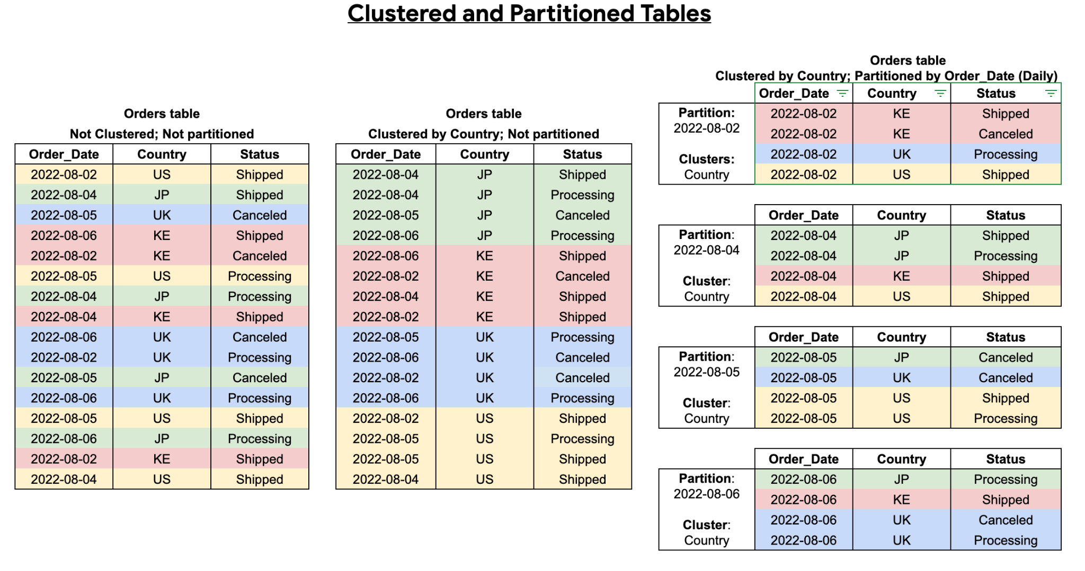

Slide 10
Limitations of BigQuery Clustering
Only GoogleSQL is supported for querying clustered tables and for writing query results to clustered tables.
We can only specify up to four clustering columns. If we need additional columns, should consider combining clustering with partitioning.
Hands On: https://console.cloud.google.com/bigquery

Slide 11
4. BigQuery GIS
BigQuery GIS is a feature within Google BigQuery that enables users to perform advanced geospatial analysis directly within the BigQuery environment.
It supports spatial data types such as points, lines, polygons, and multi-geometries, allowing users to represent and analyze various geographic features accurately.
It provides a rich set of spatial functions for performing geometric operations, including distance calculations, geometric transformations
We can visualize our BigQuery GIS Data using BigQuery Geo Viz . BigQuery Geo Viz is a web tool for visualizing geospatial data in BigQuery on a map, one query at a time. We can run a SQL query and display the results on an interactive map.
It allows users to create compelling visualizations and dashboards to communicate spatial insights effectively.

Slide 12
Geography Functions
Limitations of BigQuery GIS
GoogleSQL for BigQuery supports geography functions. Geography functions operate on or generate GoogleSQL GEOGRAPHY values.
The signature of most geography functions starts with ST_.
The geography functions are grouped into the different categories based on their behavior
Some of the frequently used functions are
ST_GEOGPOINT
ST_GEOGFROMTEXT
ST_ASTEXT
ST_DWITHIN
Geography functions are available only in GoogleSQL.
BigQuery GIS primarily supports spatial data stored in GeoJSON or Well-Known Text (WKT) formats, which may require data conversion for users with data in other formats.
Hands On: https://console.cloud.google.com/bigquery
https://bigquerygeoviz.appspot.com/

Slide 13
5. BigQuery ML
BigQuery ML is a machine learning tool integrated directly into Google BigQuery, enabling users to create and deploy machine learning models using SQL queries
It allows users to build and train machine learning models within bigquery without needing to move data to separate machine learning environments
It has scalability to train machine learning models on large-scale datasets efficiently.
One of the limitation is bigquery ML is tightly integrated with Google Cloud Platform, which may restrict organizations that prefer multi-cloud or on-premises solutions.
A model in BigQuery ML represents what an ML system has learned from training data.
Built in models
Linear Regression
Logistic Regression
K-means clustering

Slide 14
Linear Regression
Linear Regression is statistical method commonly used for predicting numerical values based on input features and understanding the linear relationship between variables.
Model Building Process
Model Training: We train a linear regression model on the training dataset, specifying the target variable and input features.
Model Evaluation: Evaluate the trained model's performance using metrics such as Root Mean Square Error to assess its predictive accuracy.
Prediction: Deploy the trained model to generate predictions for new data inputs.
Hands On: https://console.cloud.google.com/bigquery

Slide 15
Reference Links
https://cloud.google.com/bigquery/docs/partitioned-tables
https://cloud.google.com/bigquery/docs/clustered-tables
https://cloud.google.com/bigquery/docs/reference/standard-sql/geography_functions
https://cloud.google.com/bigquery/docs/bqml-introduction

Slide 16

↗ egen.ai

